Slide 1
Eagle CAD Workshop (5)
How to Read: Transistors

Slide 2
Two Major Types
By now we should know both of them
BJT (Bi-Polar Junction Transistor)
FET (Field Effect Transistor)
Also, two major topologies
NPN (N-Channel for FET)
BJT: Arrow pointing out
FET: Arrow pointing in
PNP (P-Channel for FET)
BJT: Arrow pointing in
FET: Arrow pointing out
For simplicity, we will only look at NPN

Slide 3
NPN BJT
Current Operated
Enough CURRENT needed to operate
Three pin-outs
Base: Signal pin to open/close connection between Collector and Emitter
Collector: ‘Positive’ side
Emitter: ‘Negative’ side

Slide 4
BJT Transistor Specifications
VCBO = Collector-Base Voltage
Maximum voltage between Collector and Base pin
VCEO = Collector-Emitter Voltage
Maximum voltage between Collector and Emitter pin
VEBO = Emitter-Base Voltage
Maximum voltage between Emitter and Base pin
ICEX = Collector Cut-off Current
Maximum current at which Collector cuts-off electrical flow
IBEX = Base Cut-off Current
Maximum current at which Base cuts-off electrical flow
IC = Collector Current
Maximum current collector can allow to flow

Slide 5
2N3904 Signal NPN Transistor
VCBO = 60V
VCEO = 40V
VEBO = 6V
ICEX = 50nA
IBEX =50nA
IC = 200mA

Slide 6
N-Channel MOSFET
Voltage Operated
Enough VOLTAGE needed to operate
Three pin-outs
Gate: Signal input pin
Drain: ‘Positive’ pin
Source: ‘Negative’ pin

Slide 7
MOSFET Transistor Specifications
VDSS = Drain to Source Voltage
Maximum voltage between Drain and Source pin
VDGR = Drain to Gate Voltage
Maximum voltage between Drain and Gate pin
VGS = Gate to Source Voltage
Maximum voltage between Gate and Source pin
ID = Continuous Drain Current
Maximum current Drain pin can hold while current flow continuously
VGS(TH) = Gate Threshold Voltage
Minimum voltage required to close between Drain and Source

Slide 8
FQP30N06L N-Channel MOSFET
VDSS = 60V
VDGR = 60V
VGS = +10V, -8V
ID = 30A
VGS(TH) = Min. 1V Max. 2V

Slide 9
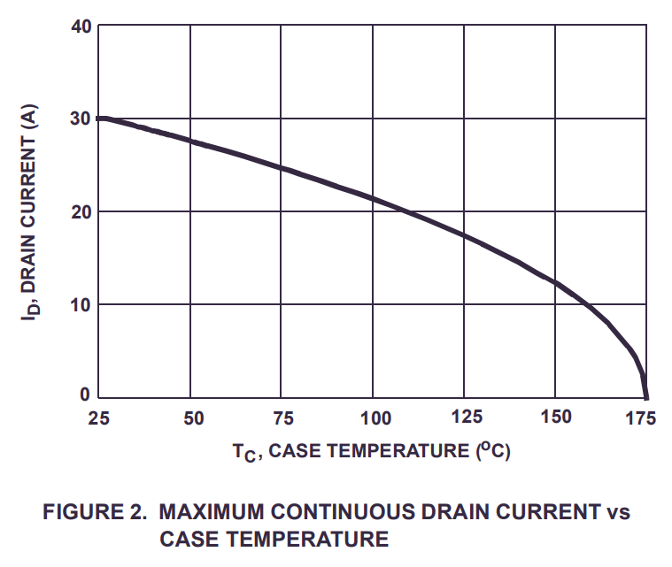
Common Parameters
Power Dissipation
Amount of thermal energy released during operation
Hotter they get, less amperage they can carry out

